Slide 1
Lung X-Ray Classification Using CNN, EﬀicientNetB0,ResNet-50 and DenseNet-121
Normal vs Viral Pneumonia Detection
Bilal Sikandar Junaid Dooast
Haji M. Husnain Ashfaq Sara Nargis
May 06, 2026

Slide 2
Introduction
Pneumonia is a major health issue worldwide. Chest X-rays are commonly used for diagnosis. Manual diagnosis can be slow and prone to errors.
Goal: Build AI-based model to classify Normal vs Viral Pneumonia.

Slide 3
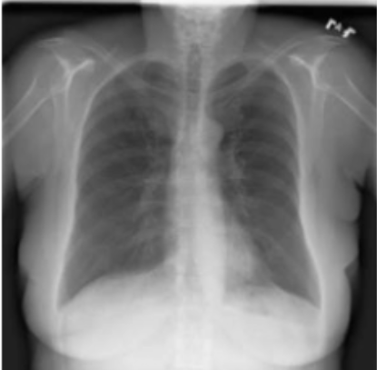
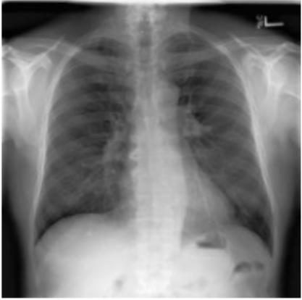
Dataset Overview
Classes: The dataset consists of two categories: Normal and Viral Pneumonia.
Total Images: 2,350 Total (1,250 Normal, 1,100 Viral Pneumonia).
Data Split: 70% Train, 20% Validation, 10% Test.
Figure: Normal Case
Figure: Viral Pneumonia

Slide 4
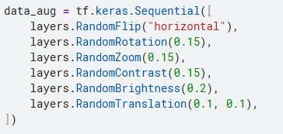
Preprocessing and Augmentation
Normalization
Random flips, rotations, zoom, contrast changes Gaussian noise added to reduce overfitting

Slide 5
MODELS

Slide 6
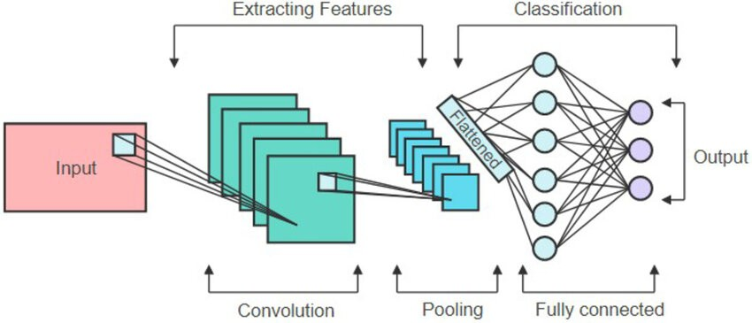
Baseline CNN Model
3 Convolutional blocks with BatchNorm Global Average Pooling
Dense layers with Dropout
Figure: Architecture Of CNN

Slide 7
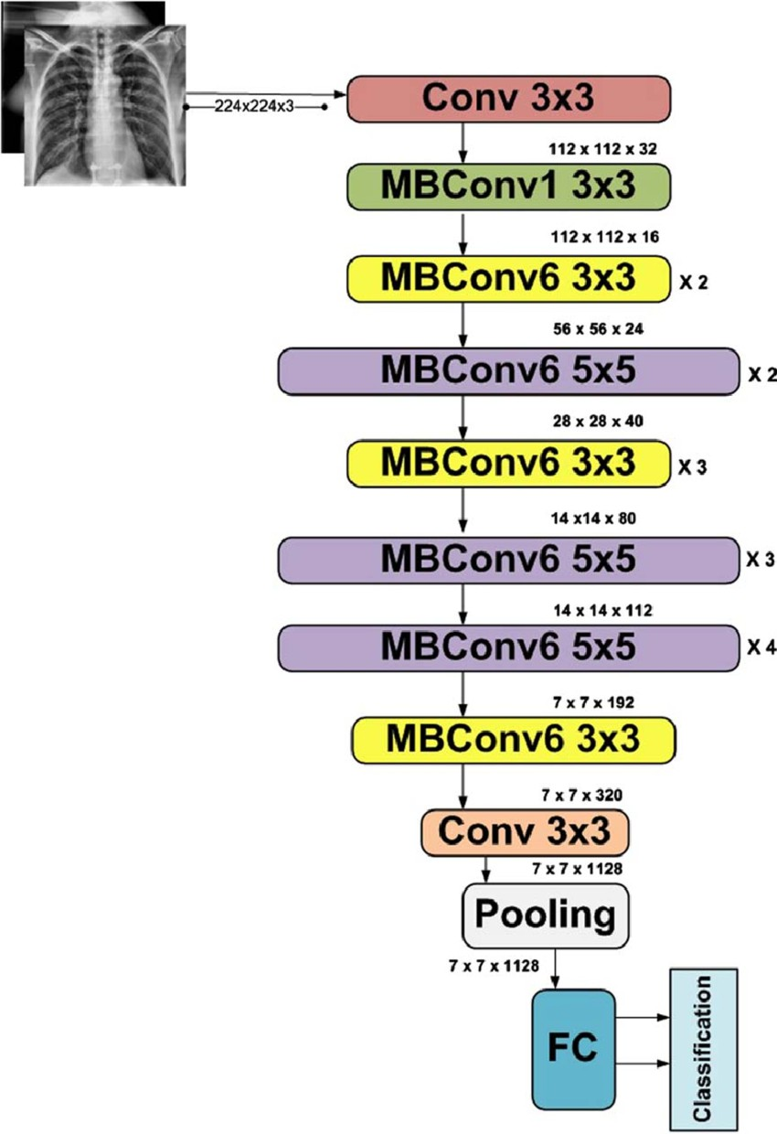
EﬀicientNetB0 Transfer Learning
Pretrained on ImageNet
Frozen base layers + custom classifier Global Average Pooling + Dense layer Tuned hyperparameters (LR, dropout, L2)
;

Slide 8
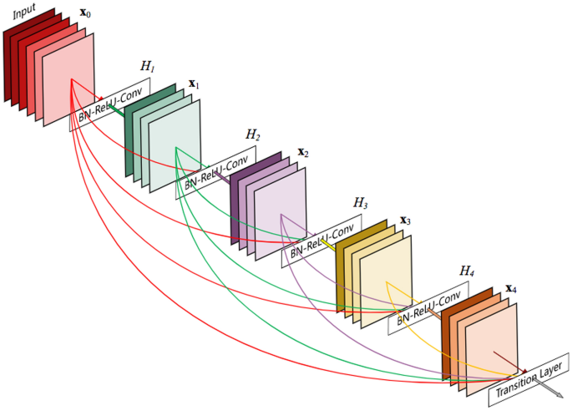
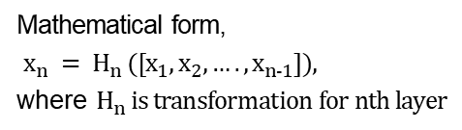
DenseNet-121
Pretrained on ImageNet
Trained in two phases:
Frozen Base layers
Partially Unfreezing Base layers
Mathematical form,
$x_{n} = H_{n} ([x_{1},x_{2},….,x_{n−1}]),$
where $H_{n} is transformation for nth layer$

Slide 9

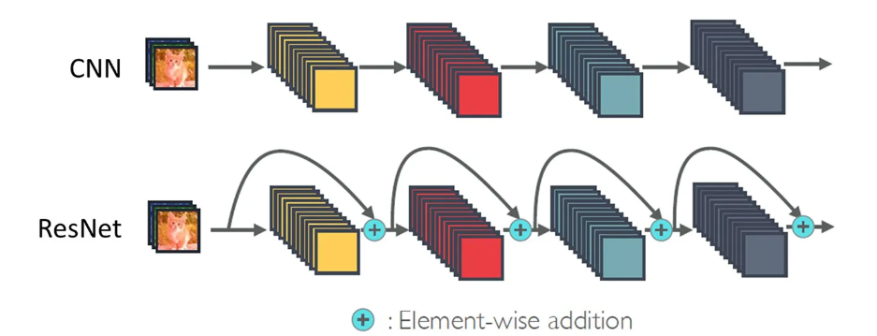

ResNet-50
Pretrained on ImageNet
Trained on the base of residual learning
Prevent the vanishing of gradient flow
Input ($L_{n+1}$) = Output ($L_{n}$) + Input ($L_{n−1}$)

Slide 10
Hyperparameter Tuning
Performed using Keras Tuner (RandomSearch / Hyperband)
and by Manual hyperparameter selection
Tuned filters, dropout, dense units, learning rate, Image size
Class weights used to address imbalance

Slide 12
RESULTS
(5-FOLD CROSS VALIDATION)

Slide 13
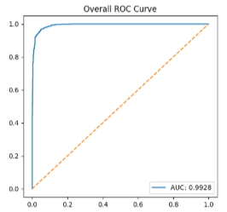
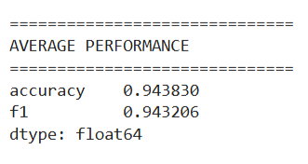
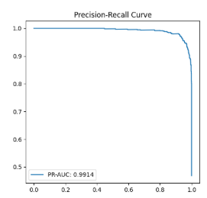
CNN

Slide 14
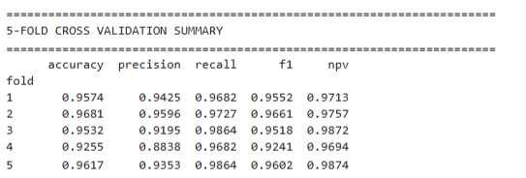
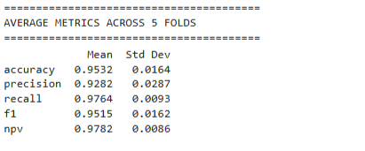
EﬀicientNetB0

Slide 15
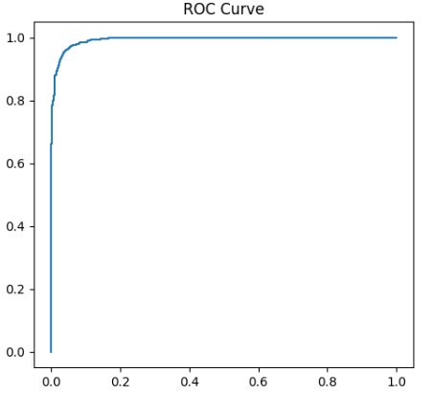
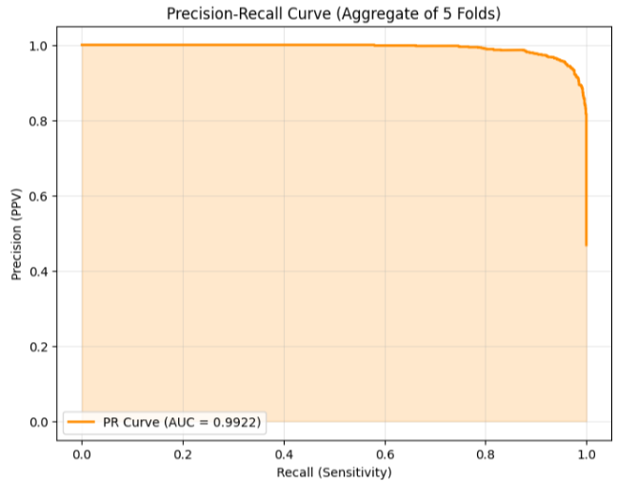
EﬀicientNetB0

Slide 16
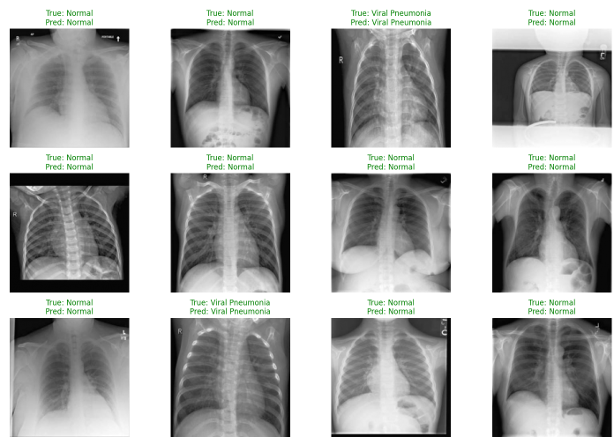
EfficientNetB0: Normal vs. Viral Pneumonia

Slide 17
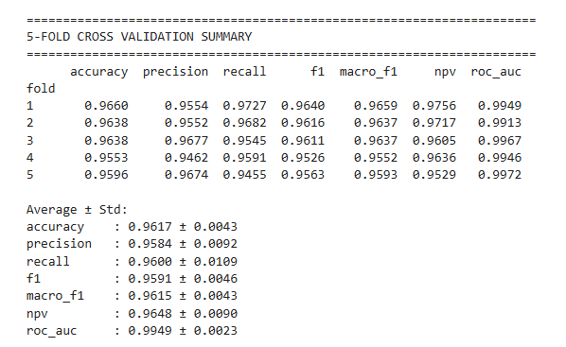
DenseNet-121

Slide 18
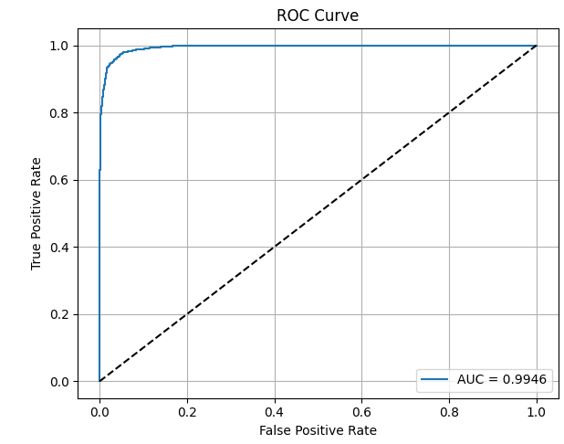
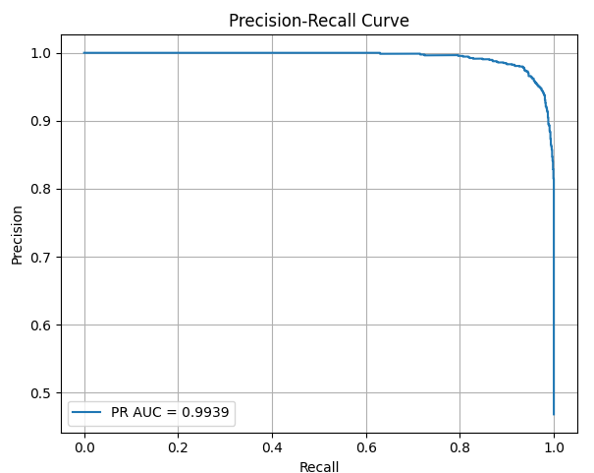
DenseNet-121

Slide 19
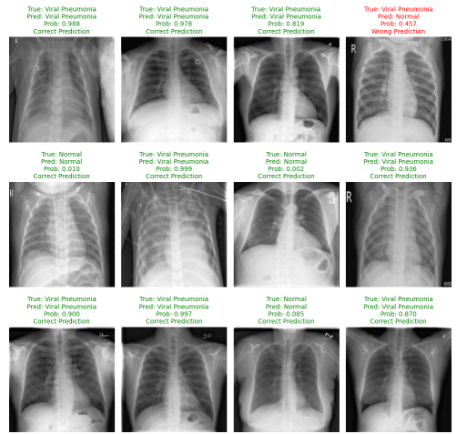
DenseNet-121: Normal vs. Viral Pneumonia

Slide 20
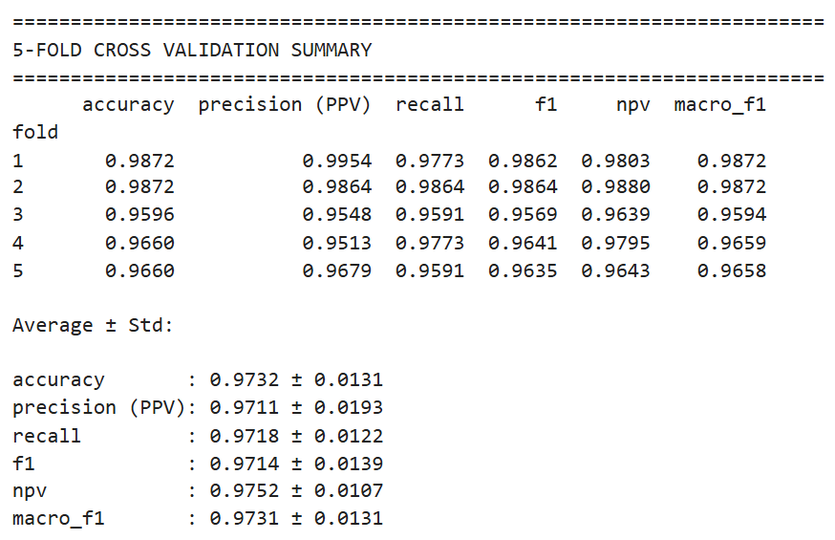
ResNet-50

Slide 21
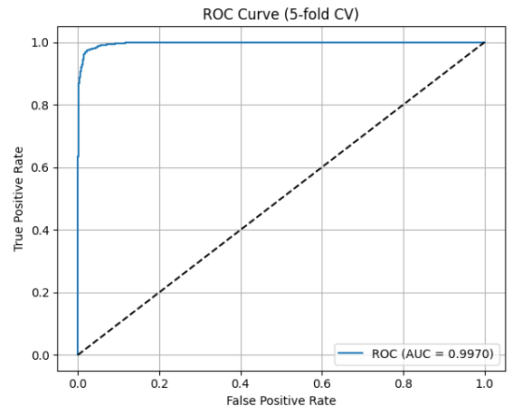
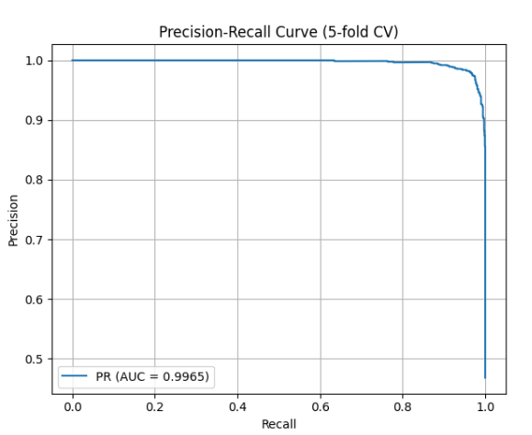
ResNet-50

Slide 22
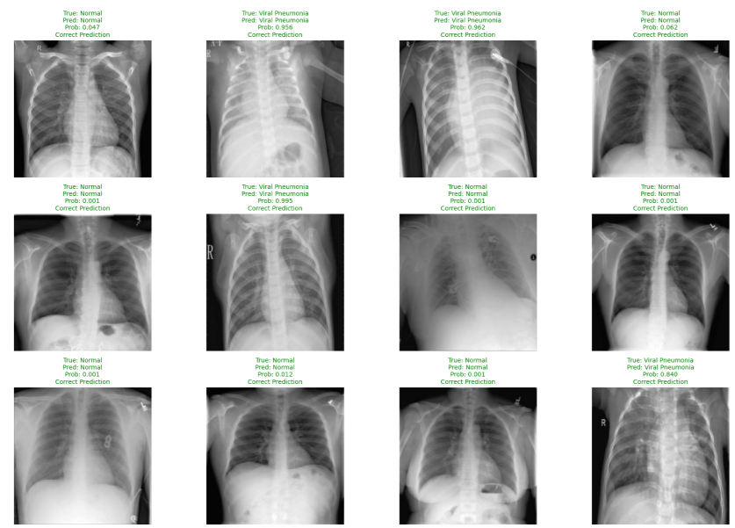
ResNet-50: Normal vs. Viral Pneumonia

Slide 23
Conclusion and Future Work
DenseNet-121 achieved highest accuracy, precision and sensitivity.
ResNEt-50_5 fold achieved highest accuracy, precision and sensitivity
Deep learning can aid rapid pneumonia diagnosis.
Future work:
Multi-class classification
Larger datasets

Slide 24
SOME OTHER RESULTS

Slide 25
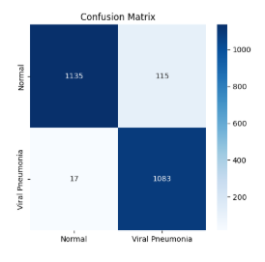
CNN

Slide 26
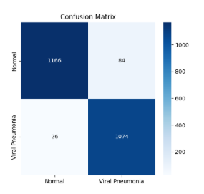
EfficientNetB0

Slide 27
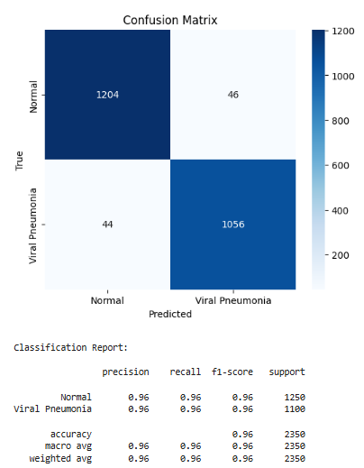
DenseNet-121

Slide 28
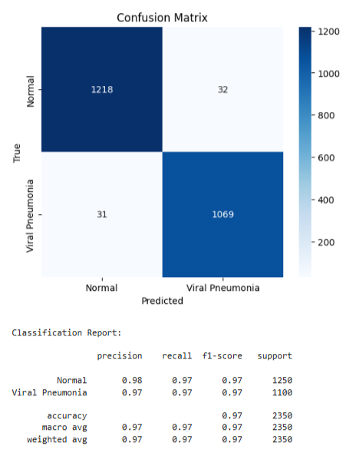
ResNet-50

